Slide 1
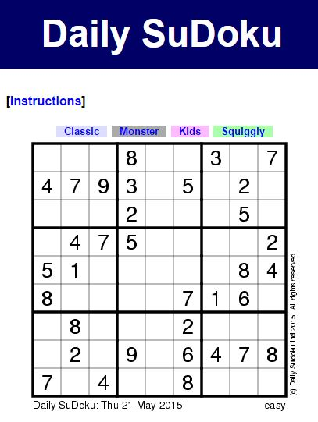
The code is developed by
Tanveer Hossain Polok
BSc in Mechanical Engineering from KUET
2k10 batch
Contact: 01673856012
Lets solve it

Slide 2
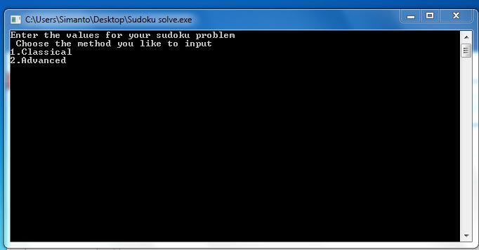
Don’t
After opening this screen will come.
Keep the screen at this size do not maximize
Tanveer Hossain Polok

Slide 3

There are 2 methods to input.
Number 1 is as we input matrix in calculator- like row1 column 1 bla bla…. So boring
But as I coded earlier in that way so I kept it. So type 2 it will be more dynamic
Press 2 in key board and then press enter

Slide 4
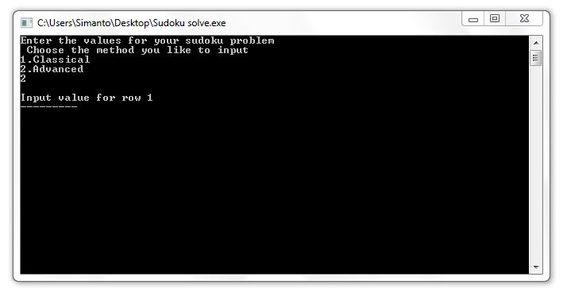
You will then see a screen like this. Put the values of a row with out pressing enter and press enter only when all the 9 values of a row is given. Put 0 for blank.
Example: write 000800307 then press enter

Slide 5
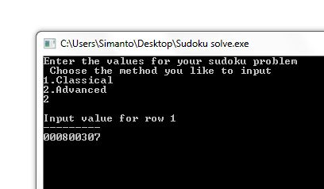
Example

Slide 6
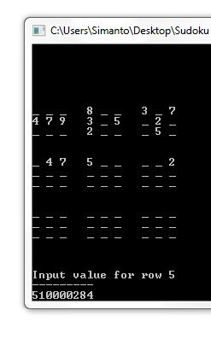
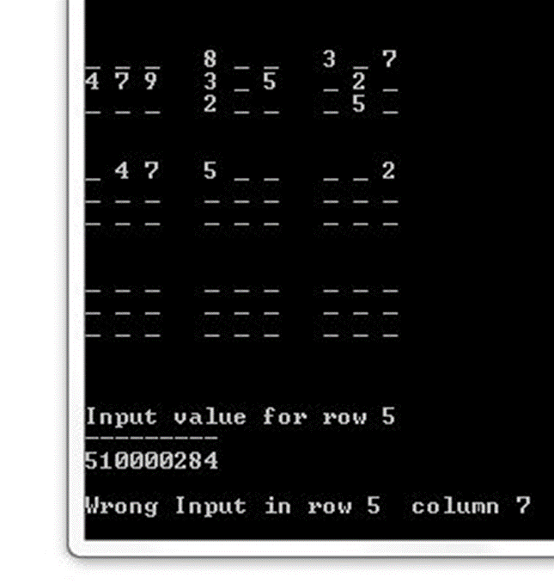
In this way
If you enter any wrong (according to Sudoku logic) input this code will also notify you. Like in the pic.
No number can repeat in a row, column or in inner box
Notification will be seen if wrong input is given. In that case press enter and retype the actual row
Actual :510000084

Slide 7
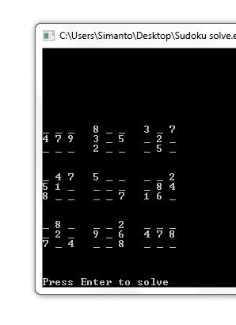
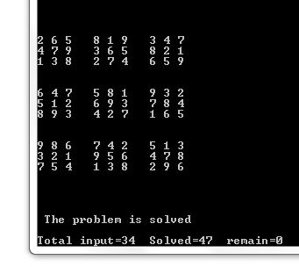
In this way
Solved
Then Press enter when all values are given input

Slide 8
Special case
For sum Sudoku it is needed to not only use logic but also use of a trial and error method. Say for example ,you are understanding that in a cell there will be either 2 or 5 . So when solving on hand you put 2 by pencil and after advancing more three steps u realized that it was wrong . Then you erase those three steps and as now u know that there will be 5 there, so you put in it. In my code I also codded that system but unfortunately there was a little bug somewhere so it was not working properly and latter at that time I got busy with my study and the work is not completed yet.
But if you got one of those Sudoku u can still solve it by using this code but in this time u also have to be involved :
First input as mentioned earlier in the code
Press enter for to solve
You will see that it solved the Sudoku in many cells but not completed it.
Write the solution in a page
Now from the semi-solved Sudoku in the page find a cell which will logically contain only 2/3 numbers( eg. 4 or 9). Put one of them there which one you like. Then put the Sudoku again in the exe file with this number for this time. Then press enter to solve.
Now if the code shows error u will understand that u chose the wrong one. So do it again for other number
Thus u will get the complete solution. Remember u may need to do the upper process for more then ones to get the solution completely
But maximum Sudoku is not that kind.

Slide 9
Try more Sudoku from internet
Thank you
The code is developed by
Tanveer Hossain Polok
BSc in Mechanical Engineering from KUET
2k10 batch
Contact: 01673856012

